Slide 1


Slide 2
Chapter 1:
Introduction to Project Management
Information Technology Project Management, Ninth Edition

Slide 3
Contents
Chapter | Title
1 | Introduction to Project Management
2 | The Project Management and Information Technology Context
3 | The Project Management Process Groups: A Case Study
4 | Project Integration Management
5 | Project Scope Management
6 | Project Time Management
7 | Project Cost
8 | Project Quality
9 | Project Stakeholder Management
11 | Project Risk Management

Slide 4
Introduction
Many organizations today have a new or renewed interest in project management
The complexity and importance of IT projects, which involve using hardware, software, and networks to create a product, service, or result, have evolved dramatically.
Notes:
The world as a whole spends nearly $10 trillion of its $40.7 trillion gross product on projects of all kinds
More than 16 million people regard project management as their profession

Slide 5


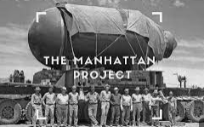
History of Project Management
Some people argue that building the Egyptian pyramids was a project, as was building the Great Wall of China
Most people consider the Manhattan Project to be the first project to use “modern” project management

Slide 6
What Is a Project?
A project is “a temporary endeavor undertaken to create a unique product, service, or result”
Projects end when their objectives have been reached or the project has been terminated
Projects can be large or small and take a short or long time to complete

Slide 7
Project Attributes
A project
  has a unique purpose
  is temporary
  requires resources, often from various areas
  should have a primary customer or sponsor
    The project sponsor usually provides the direction and funding for the project
Notes:
is developed using progressive elaboration

Slide 8
Project Example 1
manufacturing cell phone cases:
  A cell phone company is interested in manufacturing a special cell phone case for their newest model. This cell phone case is part of a promotion to sell the phone. They begin four months from today. Only 1200 of these special cases will be manufactured for distribution during the promotion. After the promotion, no further cases will be manufactured or distributed.
    is it temporary? ✓
    is it unique? ✓
    will the end of the project reach the project objectives? ✓

Slide 9
Project Example 2
manufacturing cell phone cases:
  The cell phone company has so much success with their promotional cell phone cases that customer demand has convinced them to integrate this case as part of their regular product offering. It will now be manufactured along with the other five cases that are currently offered. The cases will be manufactured until the customer demands for the phone drops.
    is it temporary? ✗
    is it unique? ✗
    will the end of the project reach the project objectives? ✗
  It is not a project; it is an operation work.

Slide 10
Examples of IT Projects
A team of students creates a smartphone application and sells it online
A small software development team adds a new feature to an internal software application for the finance department
A college upgrades its technology infrastructure to provide wireless Internet access across the whole campus
Notes:
A large network of healthcare providers updates its information systems and procedures to reduce hospital acquired diseases.
A company develops a driverless car.
A company implements a new system to increase sales force productivity and customer relationship management that will work on various laptops,
smartphones, and tablets.
• A television network implements a system to allow viewers to vote for contestants and provide other feedback on programs via social media sites.
• A government group develops a system to track child immunizations.
• A large group of volunteers from organizations throughout the world develops standards for environmentally friendly or green IT.
• A global bank acquires other financial institutions and needs to consolidate systems and procedures.
• Government regulations require monitoring of pollutants in air and water.
• A multinational firm decides to consolidate its information systems into an integrated enterprise resource management approach.

Slide 11
The Triple Constraint
Scope:
What is the project trying to accomplish? What unique product or service does the customer or sponsor expect from the project?
Time:
How long should it take to complete the project? What is the project schedule?
Cost:
What should it cost to complete the project?

Slide 12
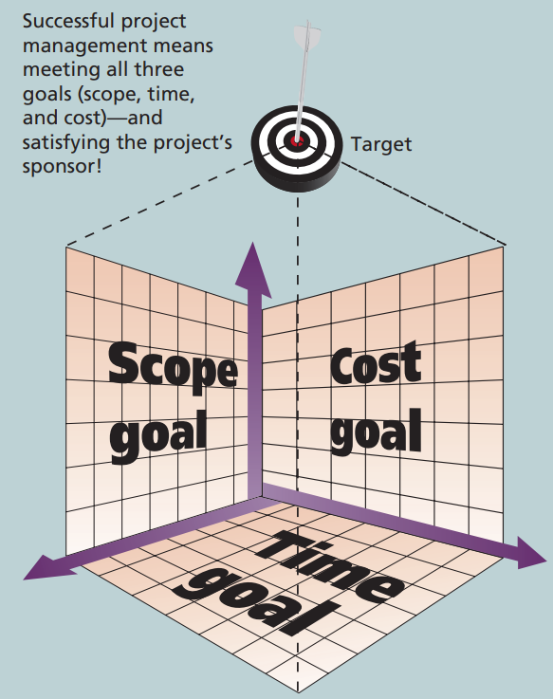
Figure 1-1 Project Constraints
Quality

Slide 13
What is Project Management?
Project management is “the application of knowledge, skills, tools and techniques to project activities to meet project requirements”
The art of organizing, leading, reporting and completing a project through people

Slide 14
The Role of the Project Manager
Project managers strive to meet the triple constraint (project scope, time, and cost goals) and facilitate the entire process to meet the needs and expectations of project stakeholders
Job descriptions vary, but most include responsibilities like planning, scheduling, coordinating, and working with people to achieve project goals
Notes:
Remember that 97% of successful projects were led by experienced project managers, who can often help influence success factors

Slide 15
Project Stakeholders
Stakeholders are the people involved in or affected by project activities
Stakeholders include
  the project sponsor
  the project manager
  the project team
  support staff
  customers
  users
  suppliers
  opponents of the project

Slide 16
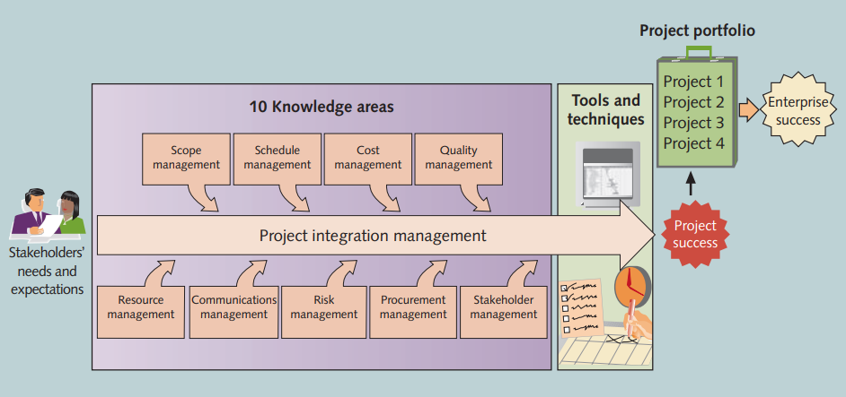
Figure 1-2 Project Management Framework

Slide 17
10 Project Management Knowledge Areas
Knowledge areas describe the key competencies that project managers must develop
Project managers must have knowledge and skills in all 10 knowledge areas (project integration, scope, time, cost, quality, human resource, communications, risk, procurement, and stakeholder management)

Slide 18
Project Success
There are several ways to define project success:
  The project met scope, time, and cost goals
  The project satisfied the customer/sponsor
  The results of the project met its main objective, such as making or saving a certain amount of money, providing a good return on investment, or simply making the sponsors happy

Slide 19
Project and Program Managers
Project managers work with project sponsors, project team, and other people involved in a project to meet project goals
Program: group of related projects managed in a coordinated way to obtain benefits and control not available from managing them individually
Program managers oversee programs; often act as bosses for project managers

Slide 20
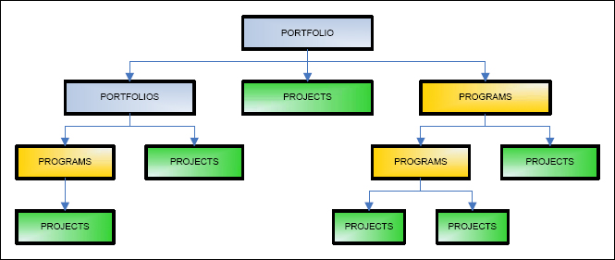
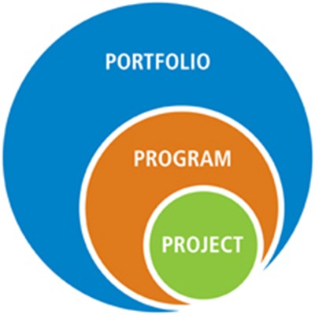
Project, Program, and Portfolio
A portfolio refers to projects, programs, sub-portfolios, and operations managed as a group to achieve strategic objectives.

Slide 21
Project Portfolio Management
Project portfolio management (PPM) is the centralized management of an organization's projects. While these projects may or may not be related, they are ﻿managed under one umbrella (called a portfolio) to oversee and manage any competing resources.
Portfolio managers help their organizations make wise investment decisions by helping to select and analyze projects from a strategic perspective

Slide 22
Suggested Skills for Project Managers
Project managers need a wide variety of skills
Project managers need both “hard” and “soft” skills.
  Hard skills include product knowledge and knowing how to use various project management tools and techniques, and
  soft skills include being able to work with various types of people

Slide 23
Ten Most Important Skills and Competencies for Project Managers
1. People skills
2. Leadership
3. Listening
4. Integrity, ethical behavior, consistent
5. Strong at building trust
6. Verbal communication
7. Strong at building teams
8. Conflict resolution, conflict management
9. Critical thinking, problem solving
10. Understand, balance priorities
Notes:
A Good Project Manager
Takes ownership of the whole project
Is proactive not reactive
Adequately plans the project
Is Decisive
Is a Good Communicator
Manages by data and facts not uniformed optimism
Has sound Judgement
Is a Motivator
Is Diplomatic
Can Delegate

Slide 24
Importance of Leadership Skills
Effective project managers provide leadership by example
A leader focuses on long-term goals and big-picture objectives while inspiring people to reach those goals
A manager deals with the day-to-day details of meeting specific goals
Project managers often take on the role of both leader and manager

Slide 25
The Project Management Institute
The Project Management Institute (PMI) is an international professional society for project managers founded in 1969
There are communities of practices in many areas, like information systems, financial services, and health care
Project management research and certification programs continue to grow
Students can join PMI at a reduced fee and earn the Certified Associate in Project Management (CAPM) certification(see www.pmi.org for details)

Slide 26
Project Management Certification
PMI provides certification as a Project Management Professional (PMP)
A PMP has documented sufficient project experience, agreed to follow a code of ethics, and passed the PMP exam

Slide 27
Chapter Summary
A project is a temporary endeavor undertaken to create a unique product, service, or result
Project management is the application of knowledge, skills, tools, and techniques to project activities to meet project requirements
A program is a group of related projects managed in a coordinated way
Project portfolio management involves organizing and managing projects and programs as a portfolio of investments
Project managers play a key role in helping projects and organizations succeed
The project management profession continues to grow and mature

